Slide 1

Digital Communication Final Project

Slide 2
By Team No. 14
Name | ID
Ibrahim Sobhy Ibrahim | 10
Ahmed Hassan AbdelKadar | 14
Ahmed Samir Hassanen | 19
Omar Adel Amr Fatoh | 129
Omar AbdElaziz Fahmy | 131
Yehia Hossam Ali Soliman | 259

Slide 3
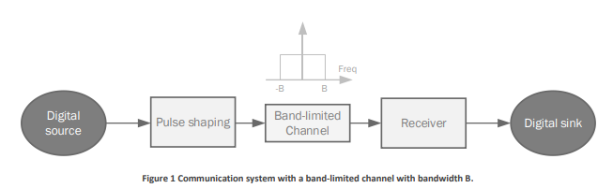
Inter-Symbol Interference due to band-limited channels
In this part, we will investigate another common channel in digital communication systems, which is the band-limited channel. As the name suggests, the channel only allows a limited range of frequency components to pass, while blocking frequency components outside this range. We investigate the simplest of such channels: a channel that has a flat response in the allowable range. Figure 1 shows the system that we will consider

Slide 4

Square Pulse Generator
B = 100 KHz
$$Tsq=\frac{2}{B }= \frac{2}{100K }=20μs$$
$$Ns= \frac{Tsq}{Ts}=Tsq ∗Fs$$
$$Fs= \frac{Ns}{Tsq}= \frac{Ns}{20μ}=\left(50K\right) Ns$$
The first thing we need to show here is the effect of a band-limited flat channel on the square signal. we need to create a band-limited channel such as the one in Figure 1, with a band 𝑩 = 𝟏𝟎𝟎 𝒌𝑯𝒛. Then generate a square pulse of duration 𝑻 = 𝟐/𝑩, pass it through the filter, and then look at the output. we need here to show the signal before and after the channel, both in time and in frequency

Slide 5
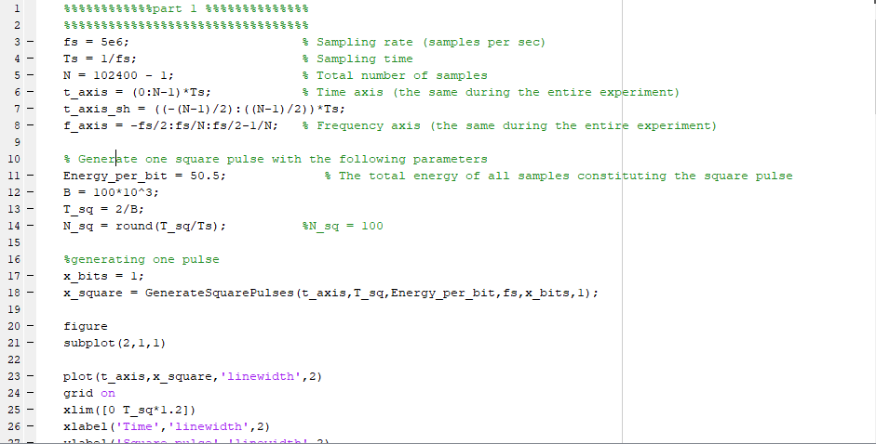
Square Pulse Generator Code

Slide 6
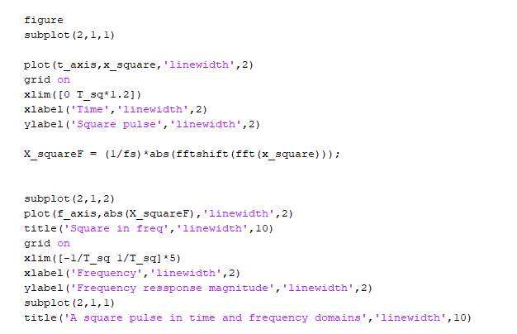
One Square Pulse Output Code

Slide 7
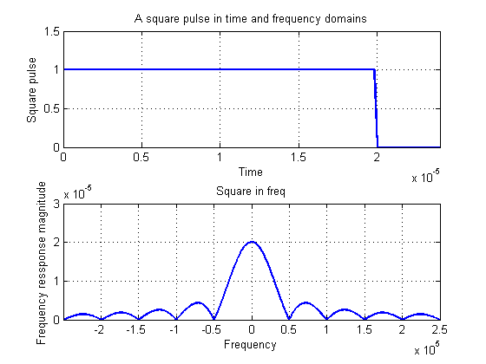
Square Pulse Generation Output

Slide 8
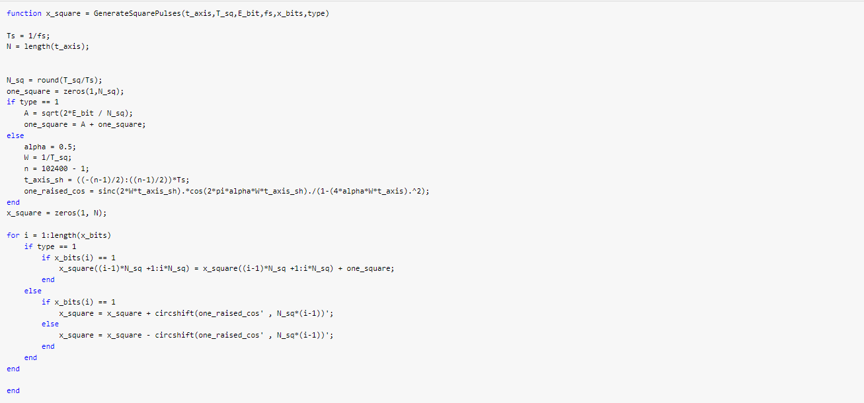
Generate Square Pulse Function

Slide 9
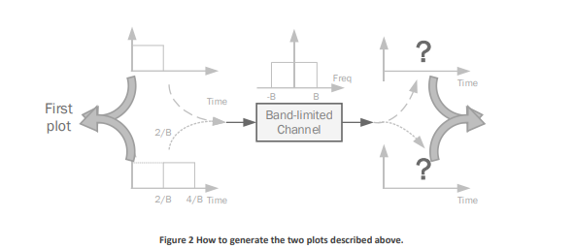
Generate two plots
The second thing we need to show is the effect of two consecutive square signals as they pass through the channel. Consider the same channel and the same square pulse duration as before. The plots we need to show here are in time domain only. Namely, 1. Show two plots of the first square pulse: one before it passes through the channel, and one after. 2. On top of the two previous plots, show similar plots for the second square pulse. Plot this pulse in the two plots using a different color, so that the shapes of the two pulses are distinguishable on the plots. 3. Note that we will have to pass the two squares separately, i.e., we cannot create the two pulses together in the same vector and pass that into the channel. If we do it this way, we won’t be able to clearly distinguish the two pulses. The procedure that we need to follow to generate the plots required above are shown in Figure 2

Slide 10
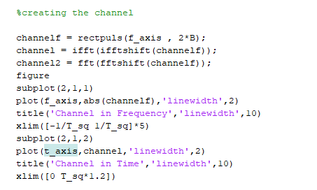
Channel Code

Slide 11
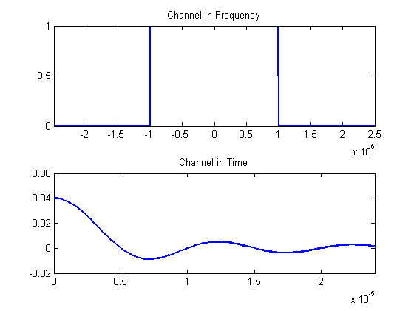
Channel Output

Slide 12
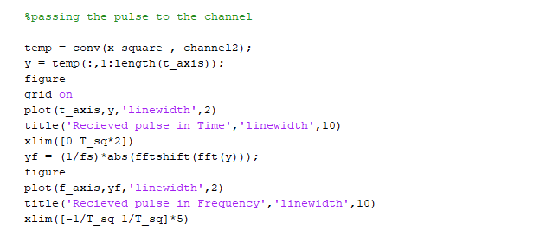
Passing Pulse to Channel

Slide 13
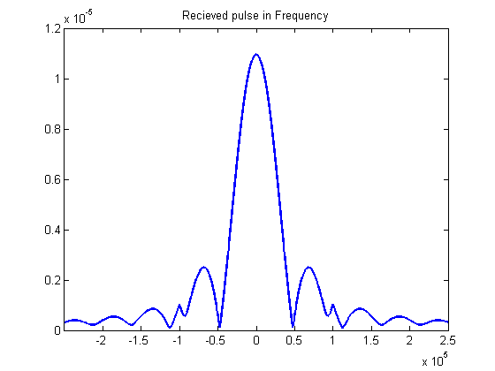
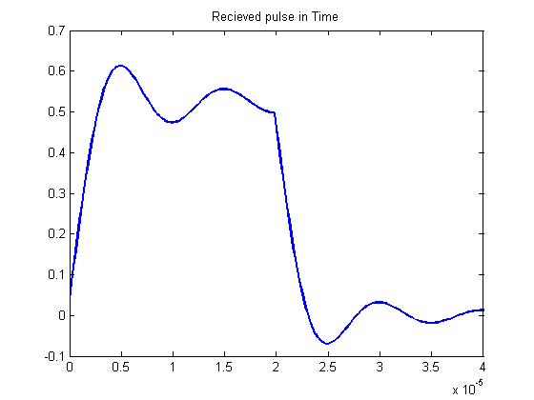
Passing Pulse to Channel

Slide 14
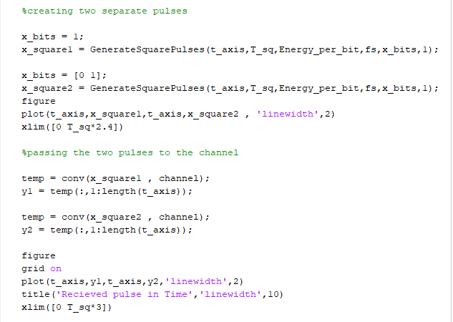
Generating Two separate Pulses

Slide 15
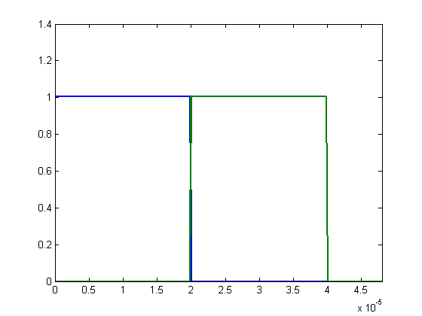
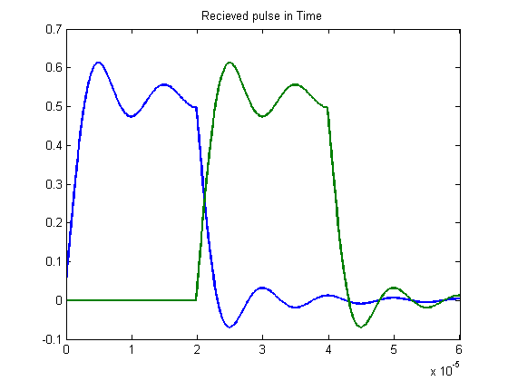
Generating Two separated Pulse

Slide 16
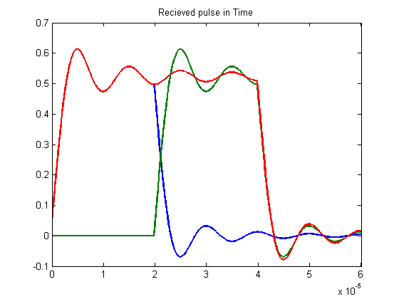
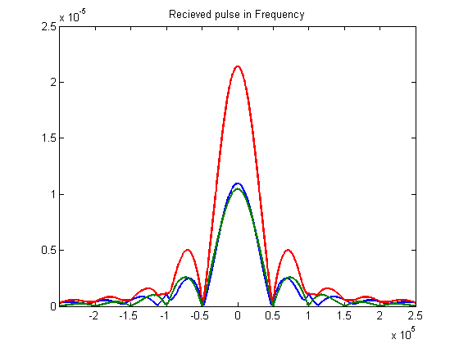
Inter-Symbol Interference (ISI)

Slide 17
Problem of ISI
As we can see, the square signal is no longer a square signal coming out of the channel. In fact, the shape of the square signal out of the channel has “leaked” outside of the duration 𝑇 = 2/𝐵 that was intended at the beginning. If there are multiple square signals after each other (one square signal for each bit), these leaked parts will interfere with the signals of other bits. This phenomenon is called Inter-Symbol Interference (ISI).
ISI can negatively affect the detection performance of multiple consecutive signals. To combat the effect of ISI in band-limited channels, one cannot use square pulses anymore. Instead, there are other pulse shapes that are better suited for such channels. We need to investigate such solutions.
So, we use raised cosine to solve the problem of ISI

Slide 18

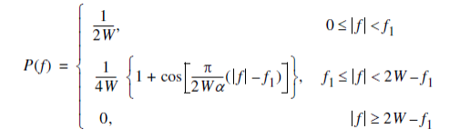
Raised Cosine Filter
The raised-cosine filter is an implementation of a low-pass Nyquist filter.
It can be produced in terms :
A) Time Domain :
B) Frequency Domain:

Slide 19
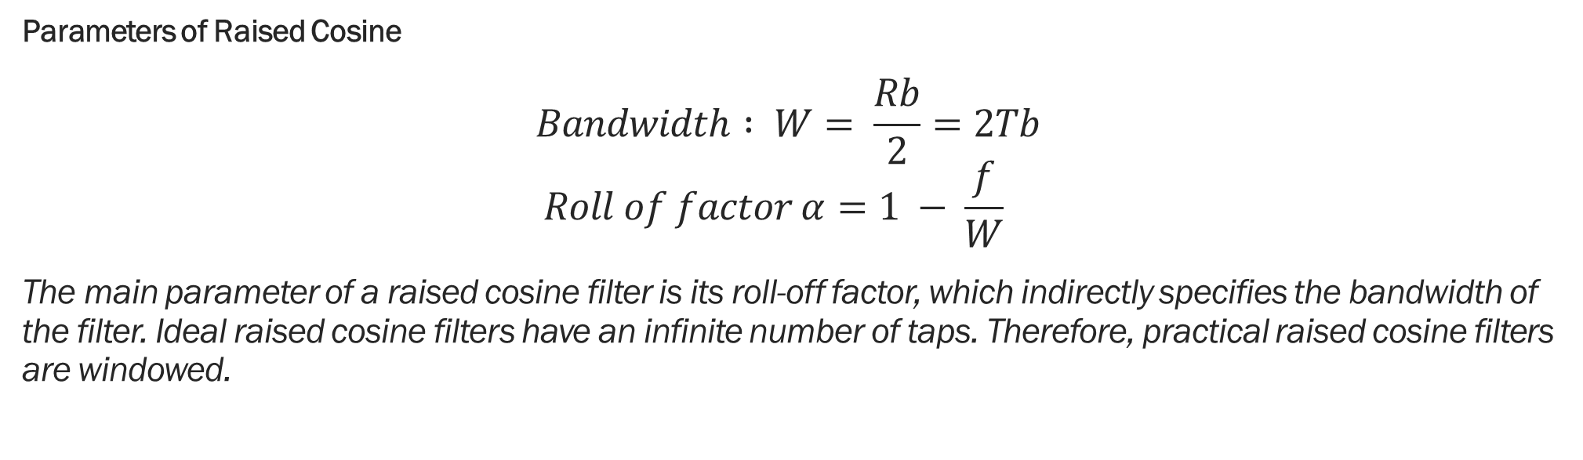
Parameters of Raised Cosine $$Bandwidth : W= \frac{Rb}{2}=2Tb \\ Roll of factor α=1 − \frac{f}{W}$$ The main parameter of a raised cosine filter is its roll-off factor, which indirectly specifies the bandwidth of the filter. Ideal raised cosine filters have an infinite number of taps. Therefore, practical raised cosine filters are windowed.

Slide 20
Generate Square Pulse Function

Slide 21
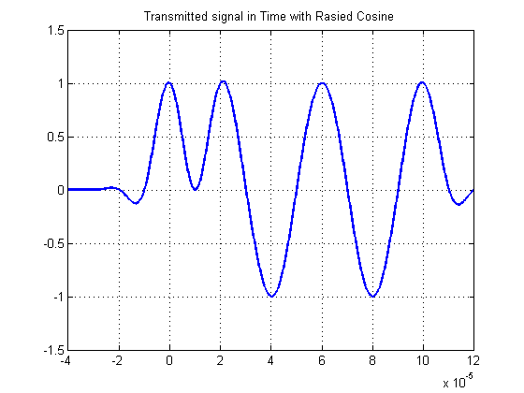
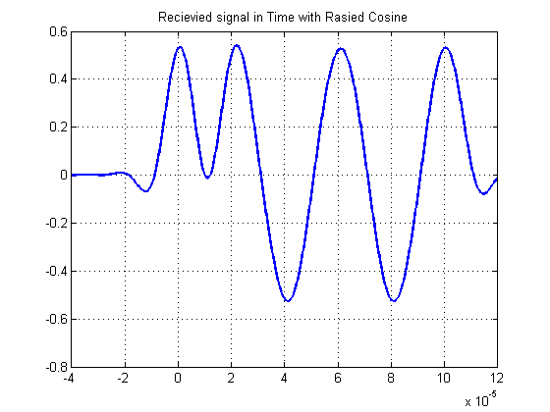
Raised Cosine Filter Output

Slide 22
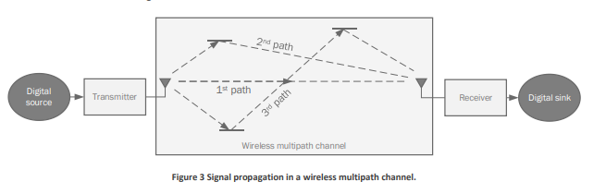
Inter-Symbol Interference due to multi-path channels
In this part, we consider another form of ISI that happens in channels that we face in wireless communication systems. The channel considered here is referred to as the multipath channel. To understand the effect of this channel, we refer to Figure 3.

Slide 23
Multi Path Channel
In wireless channels, signals are transmitted via electromagnetic waves which propagate through the air until it reaches the receiver. However, the nature of electromagnetic waves allow that multiple copies of the signal would travel around and reach the receiver at different times, such as is shown in Figure 3. This effect is what is known as the multipath effect. As is shown in the figure, a symbol transmitted by the transmitter would traverse multiple paths until it reaches the receiver. Therefore, the receiver is expected to receiver multiple copies of the same transmitted signal. Each of these copies would arrive at a different time (based on how long the path that the signal travelled through is) and with a different magnitude (based on how much attenuation that the signal suffered from during the transmission across the path).

Slide 24
Knowing 𝒀, 𝑯, and the statistics of the AWGN noise (i.e., mean and variance), what is the best way of estimating the transmitted symbols 𝑿? The goal here is to give an answer to the previous question. Note that there are several techniques to solve this equation in the literature. We can investigate one or more of these solutions.
Part 2 Question

Slide 25
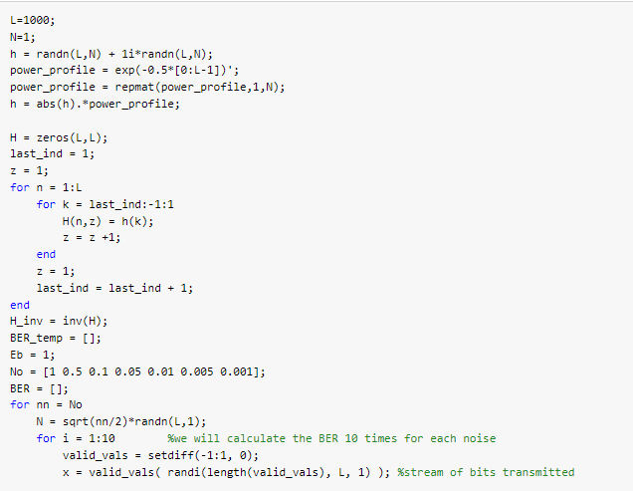

Slide 26
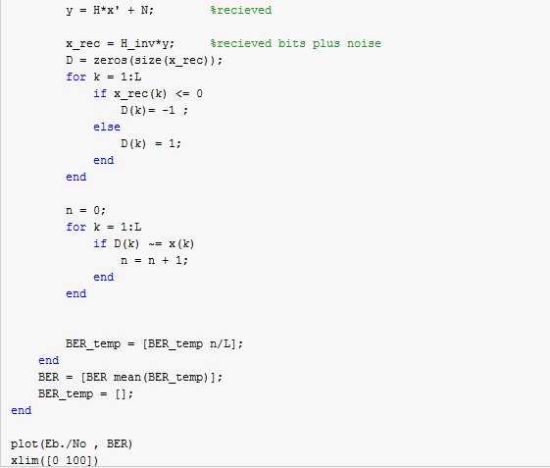

Slide 27
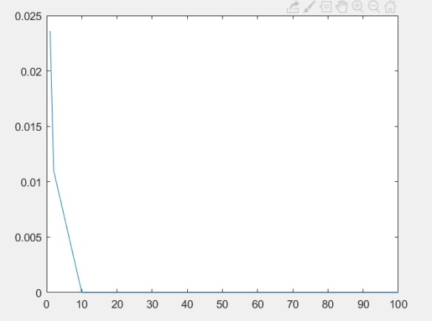
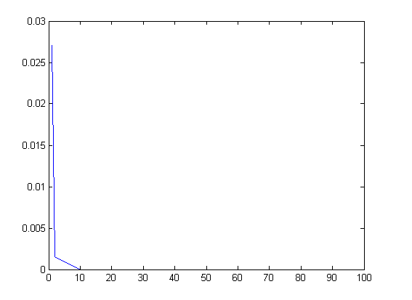
BER Calculations

